Slide 1

Notable Burials by Joshua Buchholtz

Slide 2
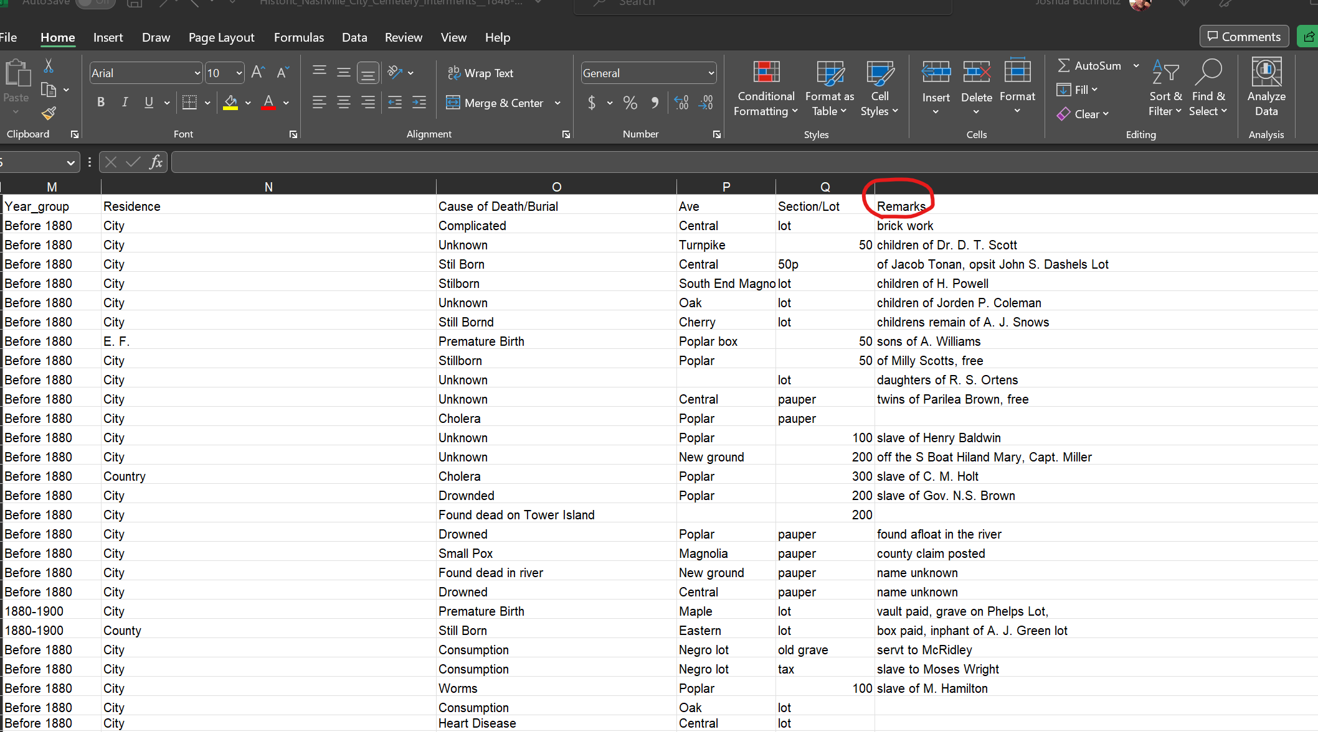
From The Data

Slide 3
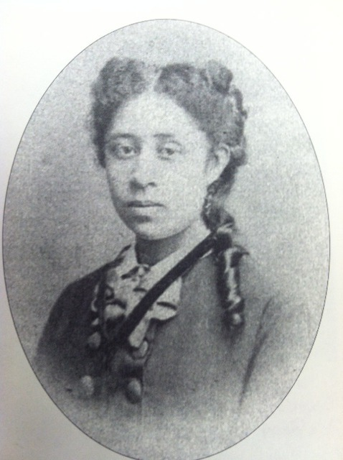

Our historic sight is the eternal resting home to some notable Nashvillian’s. This includes Mabel Imes, who was part of the original Jubilee Singers at Fisk University. The original group sang around the country and broke racial barriers, and the organization is still around today.. When you visit Nashville City Cemetery you are stepping into the past to gain insight about the future.
Notable Burials

